Slide 1
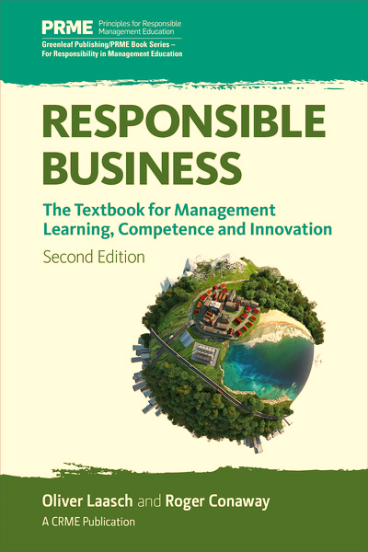

Slide 2
Contents

Slide 4
Paradoxes of “green logistics” (1/2)
Rodrigue et al. (2001)

Slide 5
Paradoxes of “green logistics” (2/2)
Rodrigue et al. (2001)

Slide 7
Practices mitigating the negative environmental impact of logistics
Two basic approaches
  Reducing the impact of individual logistics activities, while maintaining or growing the overall volume
  Reducing the logistics volume
Particular practices
  Transport impact transparency
  Eco-efficient logistics
  Reverse logistics
  E-commerce (retailing) logistics
  Servitization logistics
  Local production and consumption networks

Slide 9
Table 11.1: Comparing strategic, operations, and production management (1/2)

Slide 10
Table 11.1: Comparing strategic, operations, and production management (2/2)

Slide 11
Tools for operational improvement
Compliance with EHS management: Certain behaviors toward the environment and employee safety have become a fixed element of business operations; usually such activities are incorporated under the term “compliance.”
Operational efficiency to eco-efficiency: The responsible management tool of eco-efficiency locates and attacks areas of improvement for both better environmental performance and economic cost reduction (WBCSD, 1999).
Total quality management to total responsibility management: Achieving stakeholder satisfaction is fulfilling the responsibilities toward stakeholders. It has given birth to the term “total responsibility management” (TRM). The goal of TRM is to achieve maximum quality in responsible management within all operations of an organization (Waddock et al., 2002; Waddock and Bodwell, 2004).

Slide 12
Table 11.2: Operations approaches to responsible management (1/2)

Slide 13
Table 11.2: Operations approaches to responsible management (2/2)

Slide 15
Figure 11.1: Applying the “four Ps” to LOHAS and BoP markets

Slide 17
exercises

Slide 23
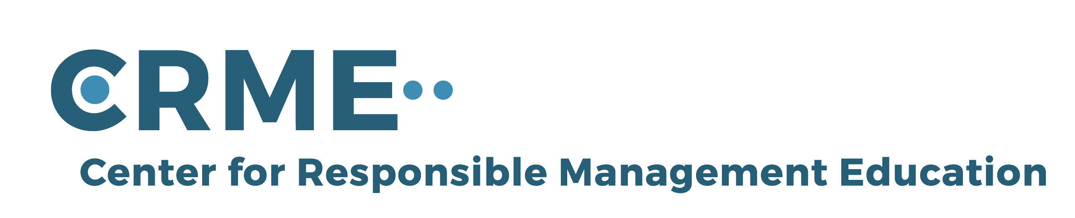
For feedback or requests regarding this presentation or the book, please feel free to get in touch through info@responsiblemanagement.net
Please also check out http://responsiblemanagement.net/

