Slide 1


Slide 2
Contents

Slide 4
Figure 17.1: Classic approaches to explaining human behavior

Slide 5
Resulting main challenges/tasks

Slide 6
Aspects of human nature impeding sustainable living (1/2)

Slide 7
Aspects of human nature impeding sustainable living (2/2)

Slide 9
What can business do to promote sustainable living?
Responsible marketing has immense potential to make an impact. If traditional marketing could question its role as a consumption increaser, to stop fueling consumerism and unsustainable behavior patterns, much would be achieved.
Education: of course, businesses are not ethics schools. Nevertheless, businesses have an enormous potential to teach sustainable, responsible, and moral competences. Many of the positive learnings from the workplace can be transferred to private life.
Human development: businesses are no development agencies either, but they do automatically contribute to human development. Businesses provide income and healthcare, often improve infrastructure themselves or through tax revenues paid, and provide or support education.

Slide 10
Figure 17.2: Kuznets curves and sustainable development

Slide 12
Figure 17.3: Sustainability of lifestyle and consumption styles

Slide 14
Business practice aligned with sustainable living
Improve the sustainability quality of products and services. As the slogan “LOHAS means business” (Emerich, 2000) suggests, this prerequisite is probably the most pleasant to be fulfilled.
Be prepared to degrow the quantity of production together with your consumers. As discussed above, the quantity of global production and consumption is already far exceeding the ecological capacity of the planet.
Create a mutually beneficial and flexible symbiosis with individuals in their roles as both consumers and employees, sensitive to the needs of new lifestyles.

Slide 16
Figure 17.4: Individual activism throughout roles and vehicles

Slide 18
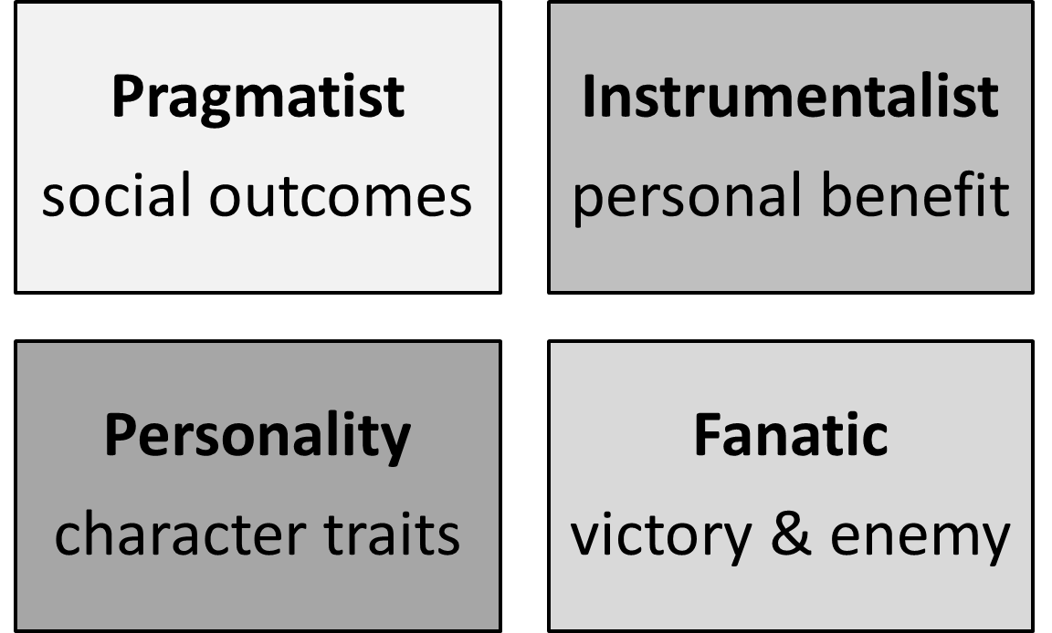
Types of change agents

Slide 21
exercises

Slide 30

For feedback or requests regarding this presentation or the book, please feel free to get in touch through info@responsiblemanagement.net
Please also check out http://responsiblemanagement.net/

