Slide 1


Slide 2
Contents

Slide 4
Figure 4.1: Dynamics and definitions

Slide 6
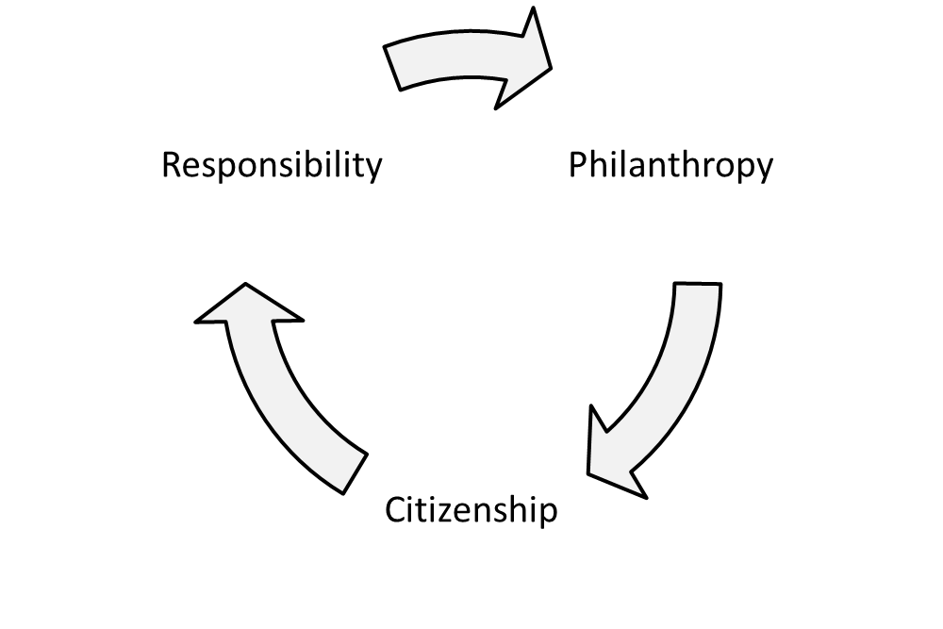
Background frameworks of business responsibility

Slide 8
Three types of corporate citizenship
(Crane and Matten, 2010a)

Slide 9
Citizens’ rights and responsibilities
(Marshall, 1977)

Slide 11
Corporate Social Responsibility
(Commission of the European Communities, 2006)

Slide 12
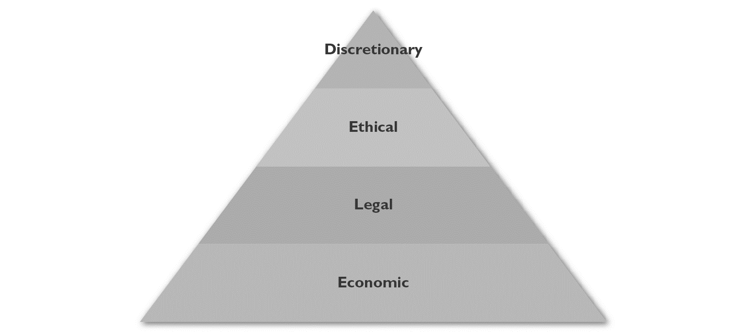
The CSR pyramid
(Carroll, 1991)

Slide 13
Levels of responsiveness
(Clarkson, 1995)

Slide 16
exercises

Slide 23
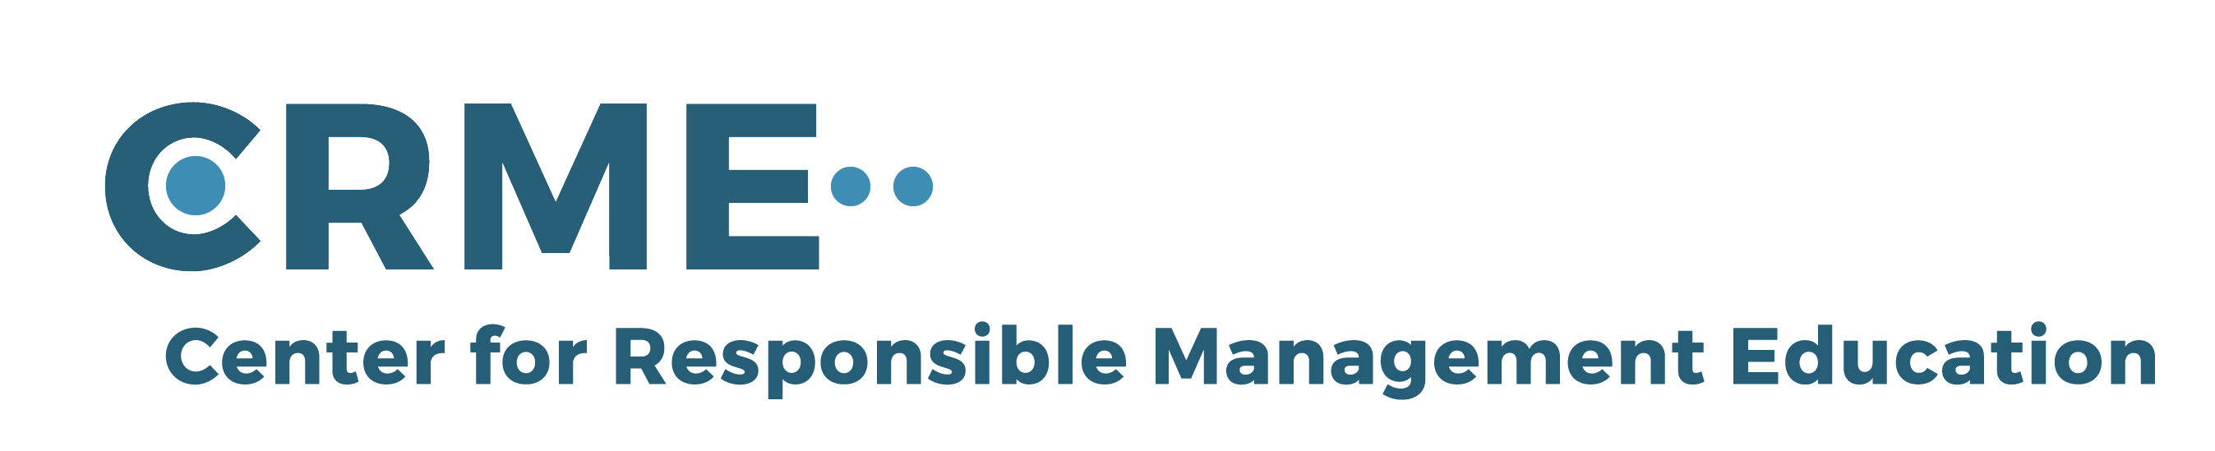
For feedback or requests regarding this presentation or the book, please feel free to get in touch through info@responsiblemanagement.net
Please also check out http://responsiblemanagement.net/

