Slide 1


Slide 3
Contents

Slide 4
Figure 6.1: Three-dimensional management and the triple bottom line

Slide 6
Table 6.1: Classifying value creation: internal-external, social-environmental-economic

Slide 9
The trinity of responsible management

Slide 10
Figure 6.2: The responsible management process trinity

Slide 14
Table 6.2: Elements and management instruments of typical responsible management activities

Slide 15
Table 6.3: Types of organizational actor and their main characteristics (1/2)

Slide 16
Table 6.3: Types of organizational actor and their main characteristics (2/2)

Slide 18
Table 6.4: Typical stakeholders and their characteristics (1/4)

Slide 19
Table 6.4: Typical stakeholders and their characteristics (2/4)

Slide 20
Table 6.4: Typical stakeholders and their characteristics (3/4)

Slide 21
Table 6.4: Typical stakeholders and their characteristics (4/4)

Slide 23
The mainstream management process (1/2)

Slide 24
The mainstream management process (2/2)

Slide 25
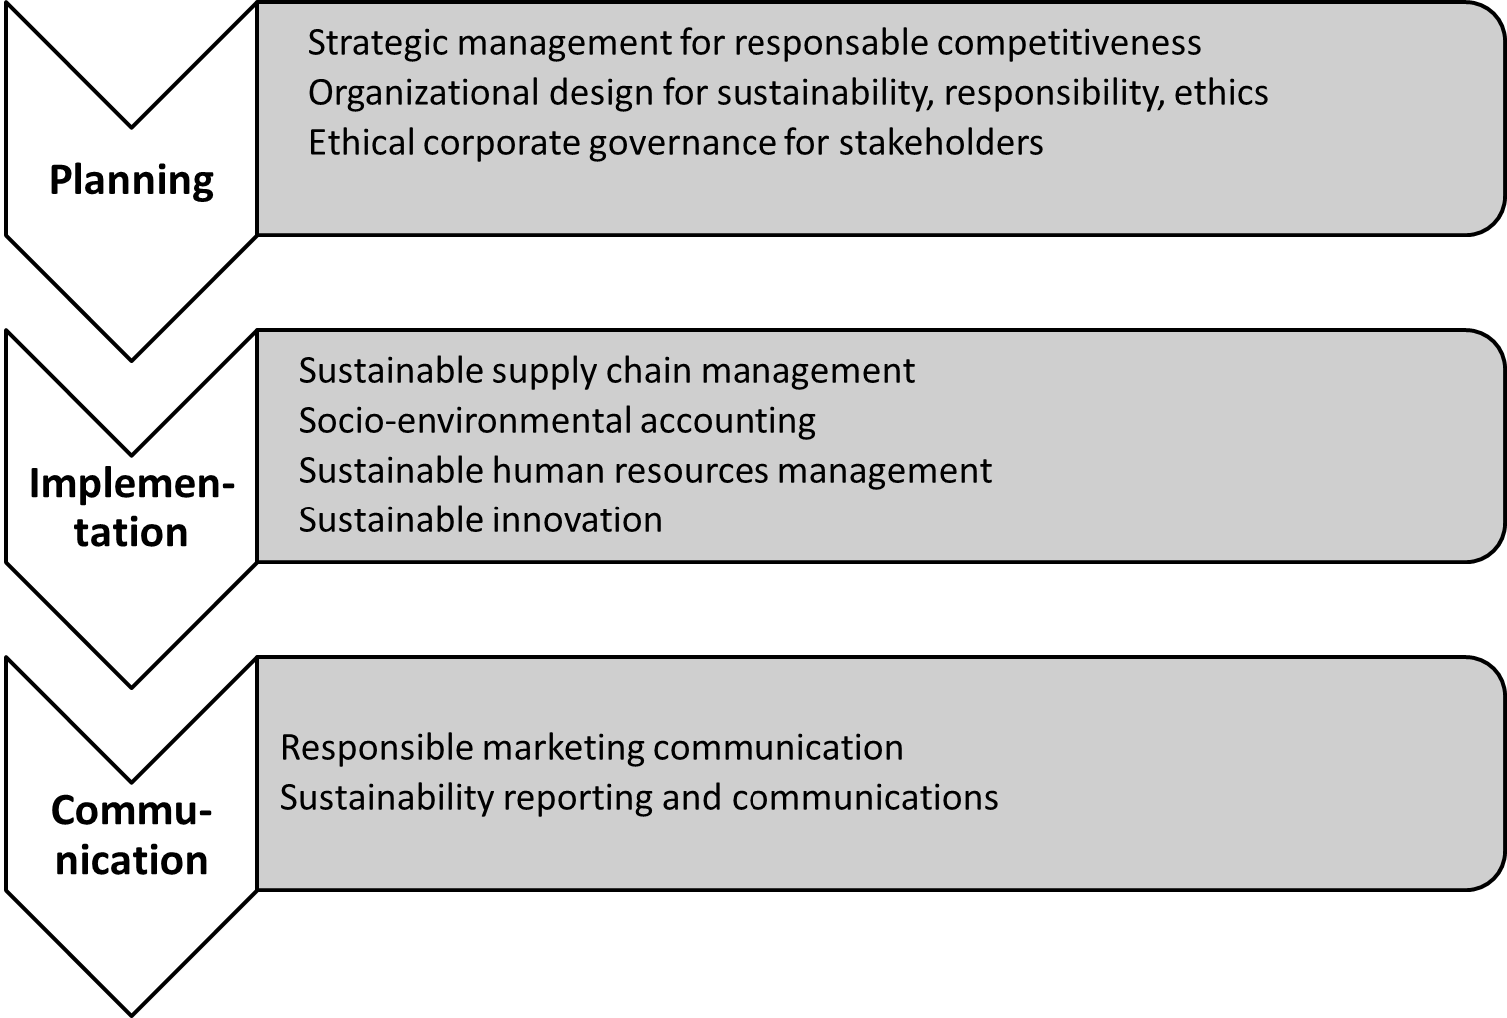
3D management across stages of mainstream management

Slide 26
Figure 6.3: Specialized responsible management instruments

Slide 27
Figure 6.4: The stakeholder management process

Slide 28
Figure 6.5: Stakeholder map of a taco restaurant

Slide 30
Table 6.5: Stakeholder categories (1/5)

Slide 31
Table 6.5: Stakeholder categories (2/5)

Slide 32
Table 6.5: Stakeholder categories (3/5)

Slide 33
Table 6.5: Stakeholder categories (4/5)

Slide 34
Table 6.5: Stakeholder categories (5/5)

Slide 35
Figure 6.6: The physical product life-cycle

Slide 36
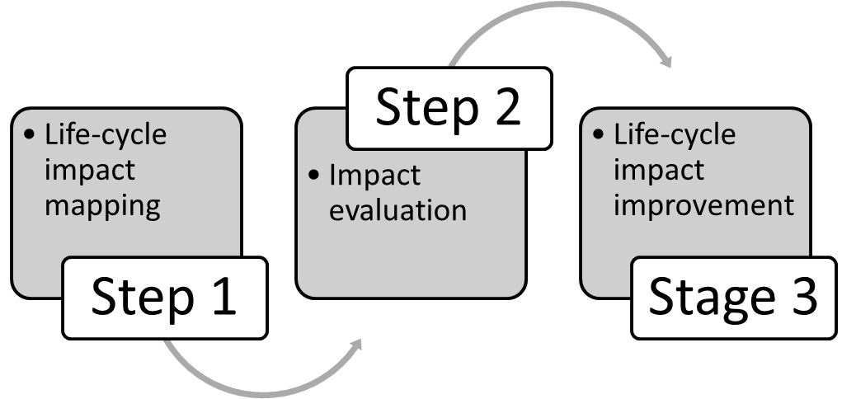
Life-cycle management process

Slide 38
Table 6.6: Typical impacts throughout the life-cycle (1/2)

Slide 39
Table 6.6: Typical impacts throughout the life-cycle (2/2)

Slide 40
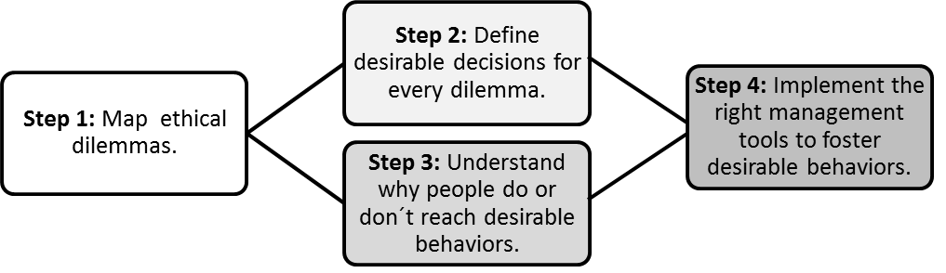
The ethics management process

Slide 41
Ethics management process (1/2)

Slide 42
Ethics management process (1/2)

Slide 44
exercises

Slide 52
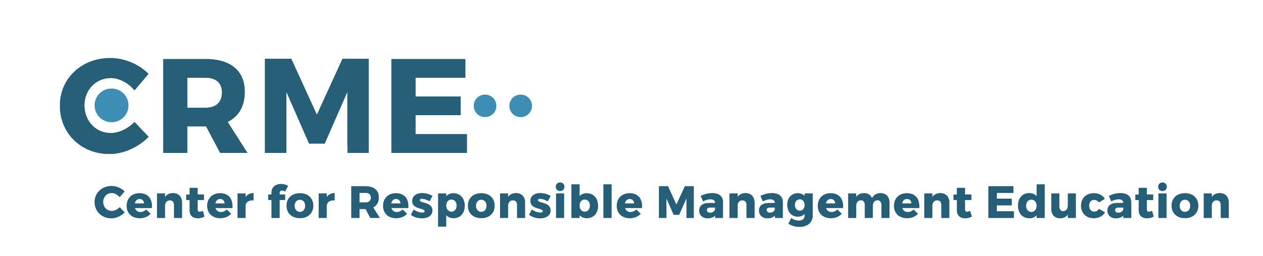
For feedback or requests regarding this presentation or the book, please feel free to get in touch through info@responsiblemanagement.net
Please also check out http://responsiblemanagement.net/

