Slide 1
by
Oliver Laasch,
Center for Responsible Management Education (CRME)
and
Roger N. Conaway,
Tecnológico de Monterrey (ITESM)

Slide 3
After reading this chapter…

Slide 5
Communication and Responsible Business Performance at Nike, Inc.
During the 1990s, Nike Inc. experienced a steep decline in its public image related to outsourcing issues. The company successfully “re-framed” the crisis into positive responses from the public.
Nike published a code of conduct on
Management practices
Impact on the environment
Safe and healthy work place
Well-being of employees
Today, Nike has become a proactive leader in many areas of responsible management, but the legacy of the past misconduct lingers on.

Slide 6
MARKETING, COMMUNICATION AND RESPONSIBLE MANAGEMENT
Effective marketing and communication of social and environmental business performance can make or break a business.
Greenwashing accusations can destroy reputations or even businesses in a short period of time.
Can reveal the imbalance between a company’s socio-environmental performance and communication activities
A single imprudent framing of a company’s responsible management issues can cost millions of dollars in stock value. While the risk of ineffective communication is significant, the opportunities of effective marketing and communication are even more important.

Slide 7
Stakeholder Goodwill and Communication
Stakeholder goodwill is the value created for an organization when its stakeholders adopt a positive attitude toward an organization.
Stakeholder communication is an ongoing dialogue with a stakeholder, any group or individual who can affect or is affected by the organization.

Slide 8
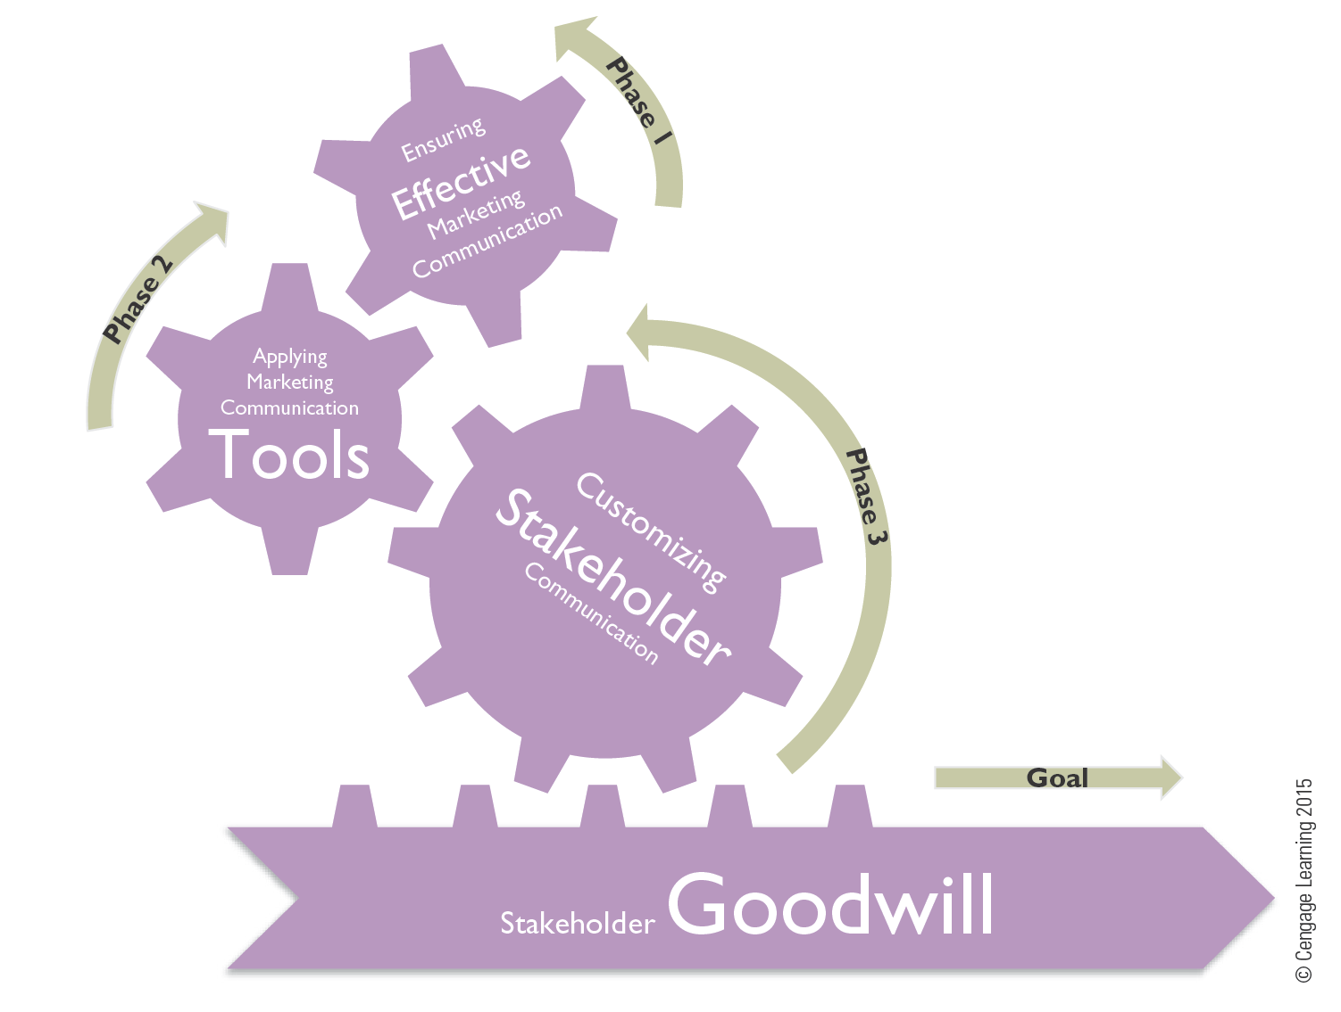
Figure 12.1 The Responsible Marketing and Communication Management Process

Slide 9
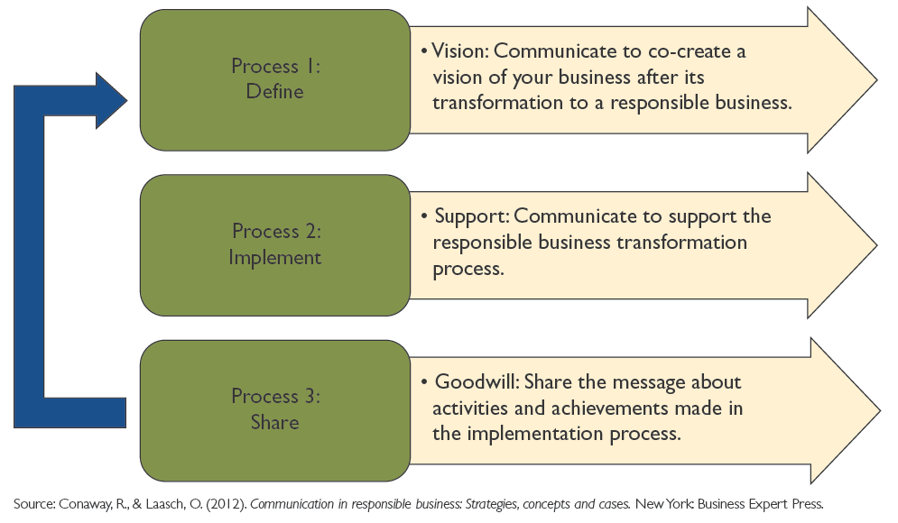
Figure 12.2 Processes and Respective Goals of Stakeholder Communication in Responsible Business

Slide 10
Ensuring Effective Integrated Marketing Communication
Phase 1

Slide 11
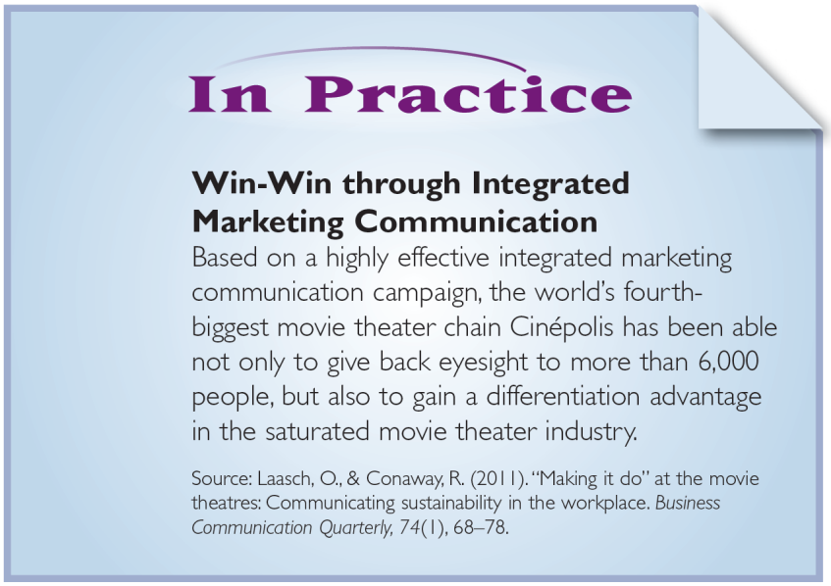
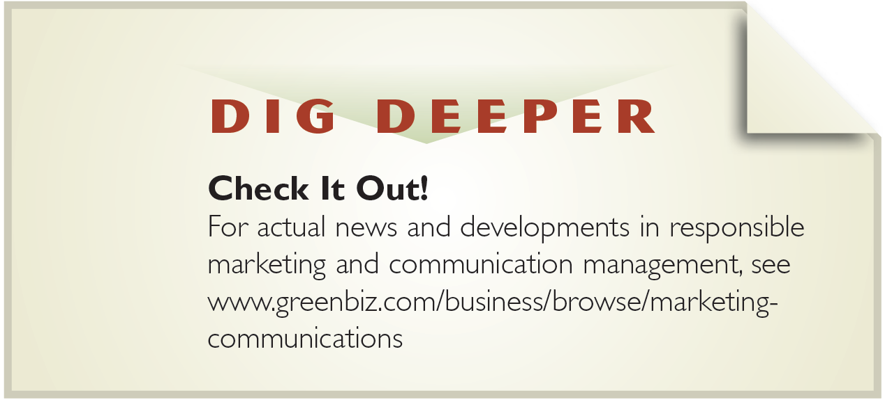
Food for Thought

Slide 12
EFFECTIVE INTEGRATED MARKETING COMMUNICATION
Effective communication occurs when messages are shared and understood.
Integrated Marketing Communication is the process of using an organization´s full range of communication and marketing tools in an interconnected manner for building stakeholder goodwill.

Slide 13
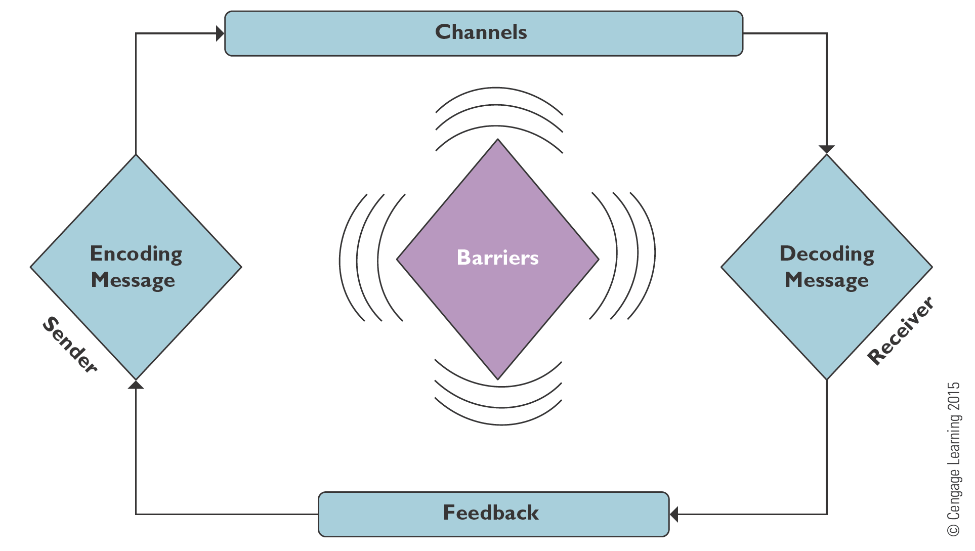
Figure 12.3 The Communication Process

Slide 14
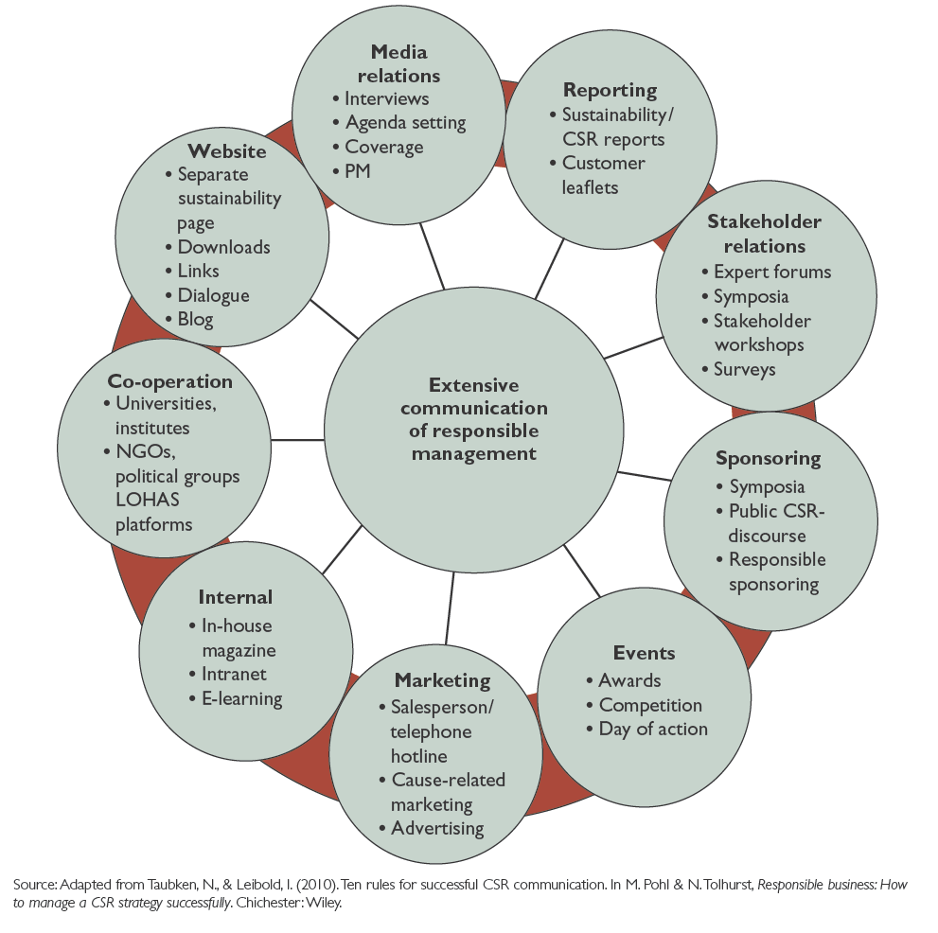
Figure 12.4 Responsibility Communication Channels

Slide 15
Shaping the Message
Apply time-tested principles of business communication which serve basis for effective stakeholder communication.
Adapt to your audience.
Clarify Your Purpose.
State your message clearly.
Stay on topic.
Be complete and accurate.
Establish goodwill.
Communicate with credibility

Slide 16
Balancing Communication and Stakeholder Value: Avoiding Greenwash
Greenwash refers to the usage of marketing and communication means to create a misleading impression of a company´s socio-environmental stakeholder value creation.
Responsibly managed companies usually display a high stakeholder value creation and a justified high activity in communicating this performance, a so called “high-balance” situation.

Slide 17
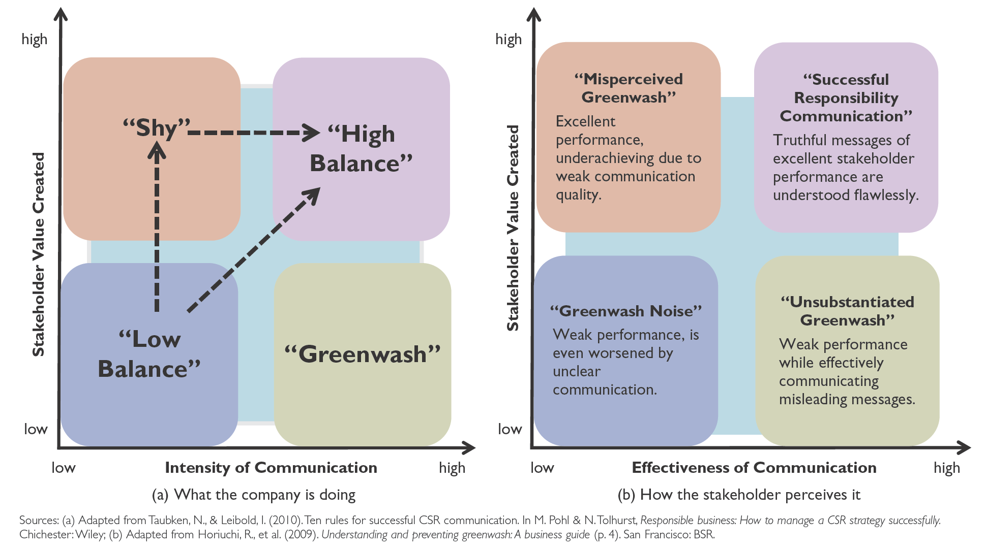
Figure 12.5 Stakeholder Value, Effectiveness, and Intensity of Communication

Slide 18
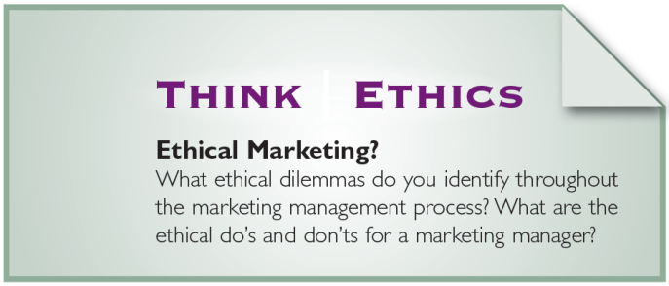
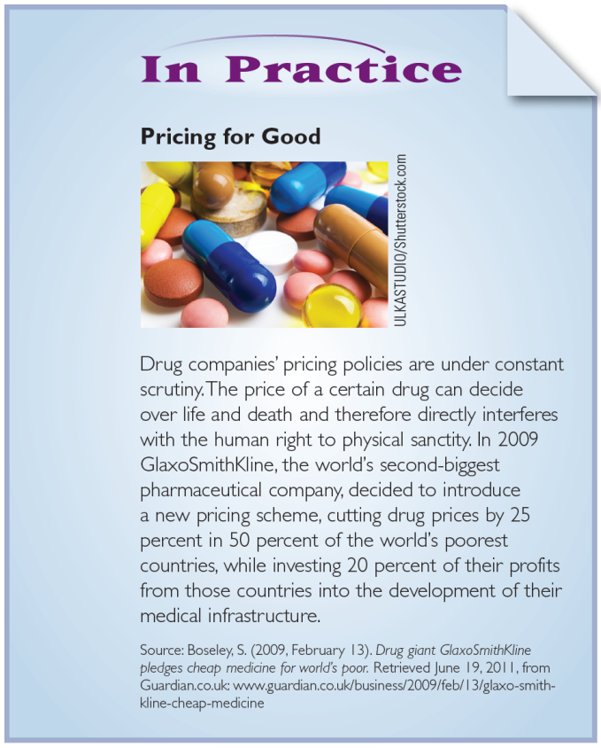
Food for Thought

Slide 19
MARKETING SOCIAL AND ENVIRONMENTAL BUSINESS PERFORMANCE
The newest AMA definition of marketing reflects a customer orientation and includes a component of social responsibility by emphasizing value for consumers in society at large.
“Marketing is the activity, set of institutions, and processes for creating, communicating, delivering, and exchanging offerings that have value for customers, clients, partners, and society at large.”

Slide 20
Figure 12.6 Responsible Management in the General Marketing Mix

Slide 21
Applying Responsible Management Marketing and Communication tools
Phase 2

Slide 22
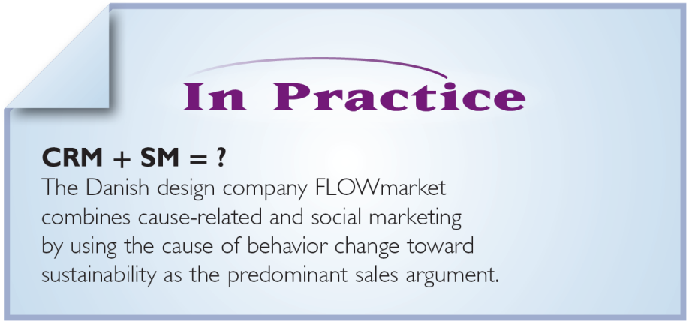
Food for Thought

Slide 23
Spheres of Communication
Internal-Operational Communication
consists of the structured communication within the organization that directly relates to achieving the organization’s work goals.
External-Operational Communication
occurs when employees communicate with people and groups outside the organization that achieves the organization’s work goals.
Personal Communication
is all the non-business-related exchange of information and feelings in which human beings engage whenever they come together.

Slide 24
Responsible Management Communication Tools
Cause-Related Marketing is the promotion of a product by linking its sales with the contribution to a good cause.
Social Marketing is an application of traditional marketing techniques in order to effect a behavior change which benefits the single individual or the society at large.
Issues and Crisis Communication is communication that occurs in any situation threatening to the company or its reputation.
Codes of Conduct are behavior standards agreed to by a company that governs relationships with various stakeholders.
Formal Sustainability Reports focus on the factual, concise and extensive description of an organization´s social and environmental business performance.
Vision and Mission Statements define an organization´s identity and purpose and serve as lighthouse guiding a company´s and its employee´s actions and behaviors.

Slide 25
Figure 12.7 Responsible Marketing and Communication Tools, Intended Communication Outcomes, and Practice Examples

Slide 26
Figure 12.8 The Social Marketing Mix

Slide 27
Customizing Stakeholder communication
Phase 3

Slide 28
Food for Thought

Slide 29
A Stakeholder Communication Model
The stakeholder information strategy is essentially a one-way communication process.
Communication is viewed by a company as ‘telling, not listening’ and may be persuasive in nature.
The stakeholder response strategy is a two-way communication process identified by communication flowing to and from the public.
The company listens to comments or feedback about its responsible activities and even changes or modifies its activities as a result.
The stakeholder involvement strategy is a dialogue or relationship with stakeholders.
The company and stakeholder engage in “sense making” and co-construction of ideas, activities, and behaviors.

Slide 30
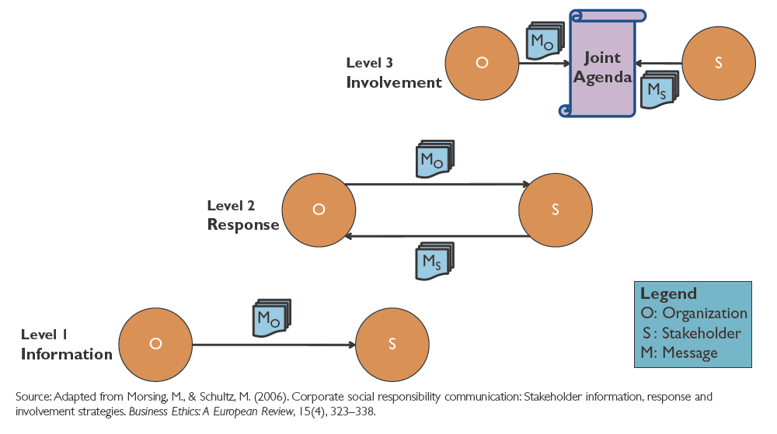
Figure 12.9 Levels of Stakeholder Communication

Slide 31
Stakeholder Audience Analysis
A primary stakeholder
is the one your company most wants to develop a relationship with, influence the most, or the one with whom the company can achieve its goal or purpose.
A secondary stakeholder
might read your communication or learn about the information, but was not the one to whom the original message was directed.
An intermediate stakeholder
may be one that simply forwards the message to others. The media, for instance, may serve as an intermediate stakeholder by announcing sustainable activities of your company to customers or investors.

Slide 32
Figure 12.10 Stakeholder Profiling Questionnaire

Slide 33
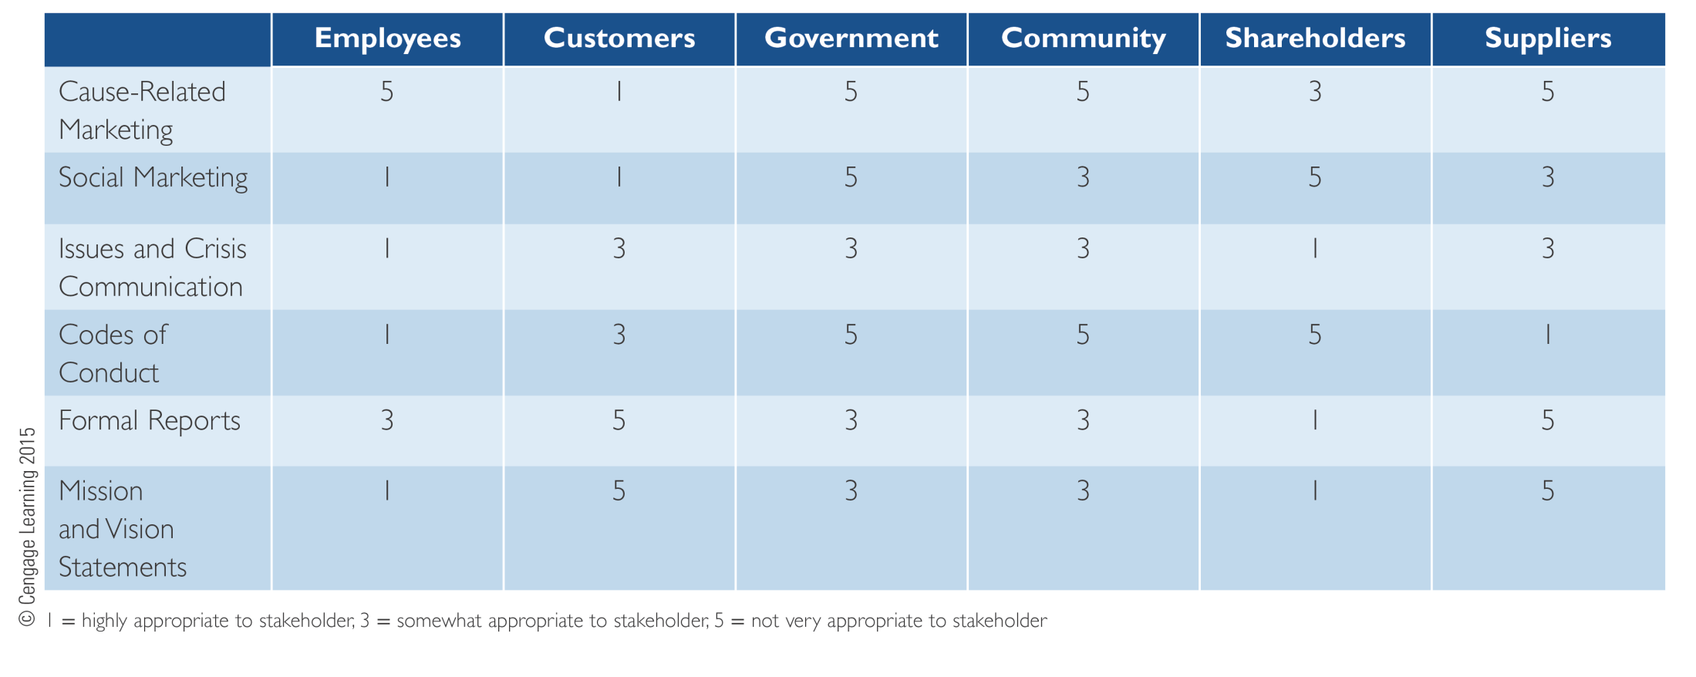
Figure 12.11 Stakeholder-Communication-Tools Matrix

Slide 34
Principles of Marketing and Communication: Stakeholder Goodwill
The goal of responsible marketing communication management is to help define the vision of a responsible business, to then support the implementation process, and to finally create stakeholder goodwill, which translates into tangible business benefits.
Stakeholder goodwill can be achieved by activities of integrated marketing communication, which serves to craft a multifaceted, but congruently connected message about organizations’ responsible management performance to the various stakeholder groups.
Effective responsible management communication is summed up in the seven principles of audience adaptation, purpose clarification, message clarity, topical conciseness, completeness and accuracy, goodwill creation, and credibility.
Effective marketing of responsible management activities depends on the successful integration of responsible management activities into the four Ps—product, price, place, and promotion—comprising the marketing mix.

Slide 35
Principles of Marketing and Communication: Stakeholder Goodwill
Successfully communicating responsible management activities requires the usage of specific responsible management communication tools. The main tools proposed in this chapter are cause-related marketing, social marketing, issues and crisis communication, formal reporting, codes of conduct, and mission and vision statements. Each tool serves a different communication purpose from increase in sales to behavior change and the assurance of ethical compliance.
Stakeholder communication types can be classified into three levels. Higher levels mean there is higher intensity in the communication activity. Level one is stakeholder information, two is response, and three is stakeholder involvement.
In order to customize the stakeholder communication tools to a specific audience, a thorough stakeholder analysis has to ensure the appropriateness of communications for distinct stakeholder groups.

Slide 36
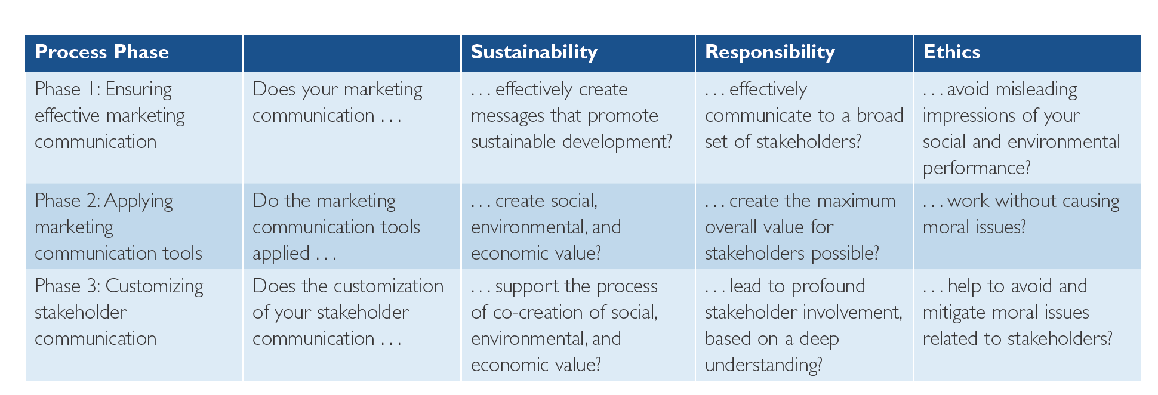
Responsible Marketing and Communication Checklist

Slide 37
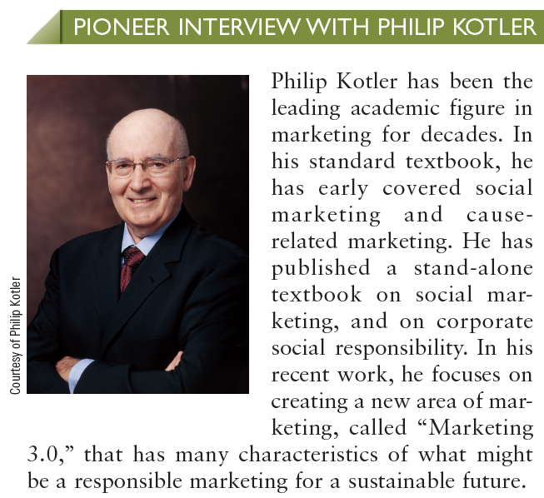
People in Marketing and Communication, Stakeholder Goodwill

