Slide 1
by
Oliver Laasch,
Center for Responsible Management Education (CRME)
and
Roger N. Conaway,
Tecnológico de Monterrey (ITESM)

Slide 3
After reading this chapter…

Slide 5
Shell in Nigeria: “Have We Got It Right?”
Issues in Nigeria
Flailing practices, oil spills
Allegations of corruption, and of involvement in the death of Ogoni leader Ken Saro Wiwa
Drivers of responsible management
Laws and standards
Business case
Stakeholder wants and needs
Discussion
Can a petroleum business ever be sustainable and responsible?
Are the Shell Business Principles the answer?

Slide 6
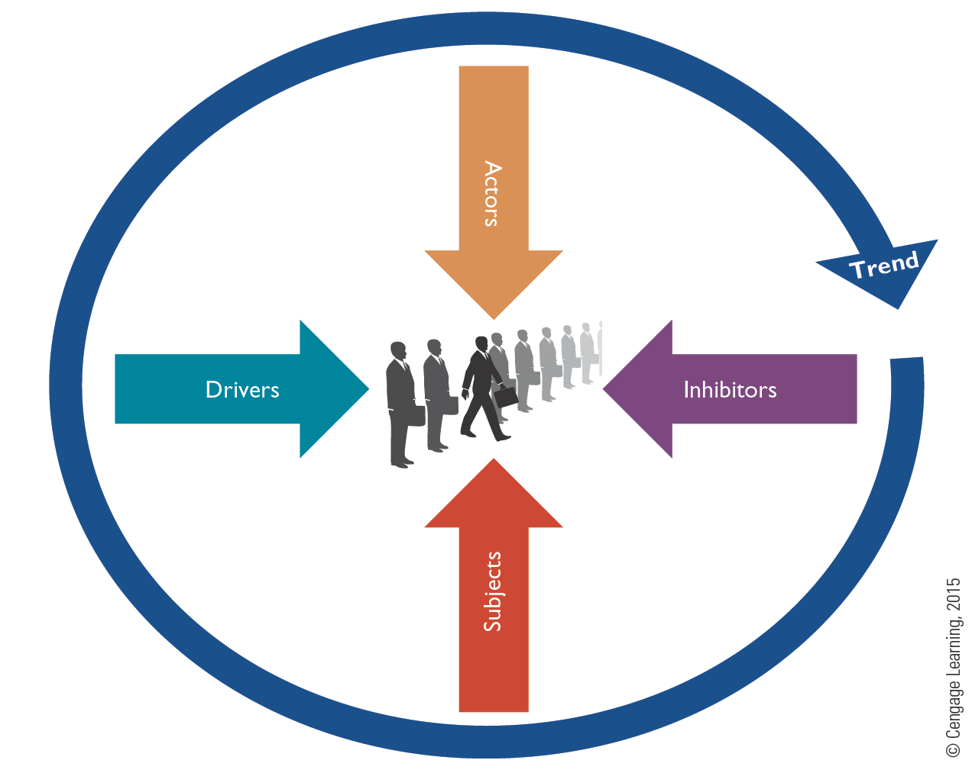
The Context of Responsible Management

Slide 7
SUBJECTS AND ACTORS OF RESPONSIBLE MANAGEMENT

Slide 8
Food for Thought

Slide 9
Background Domains and Core Concepts
Sustainability
Triple bottom line
Responsibility
Stakeholder
Ethics
Moral dilemma

Slide 10
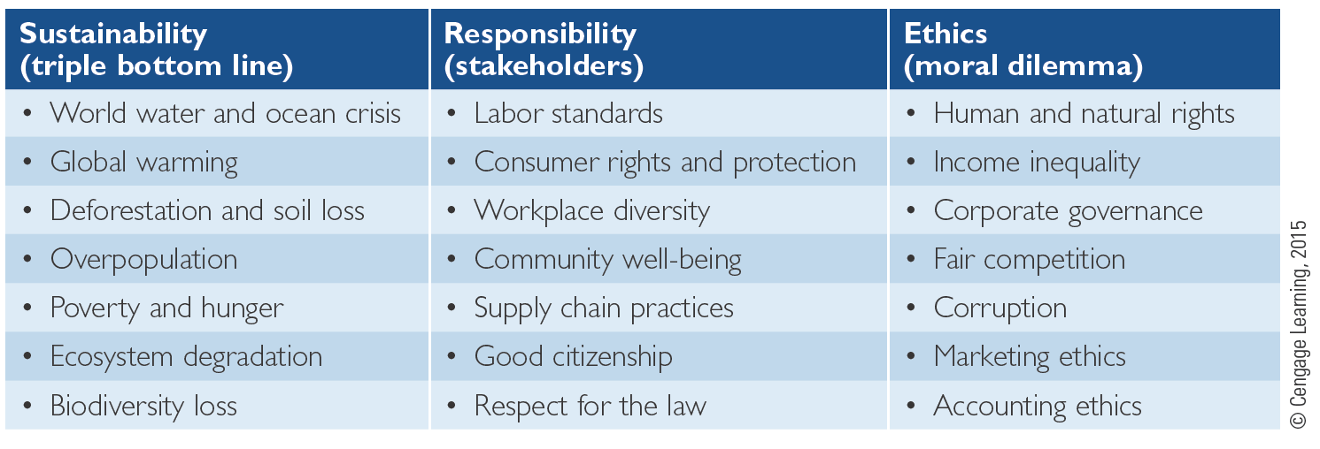
Table 1.1 Responsible Management Subjects Structured by Background Disciplines

Slide 11
Sectorial Actors
Sectors
Governmental
Civil Society
Business

Slide 12
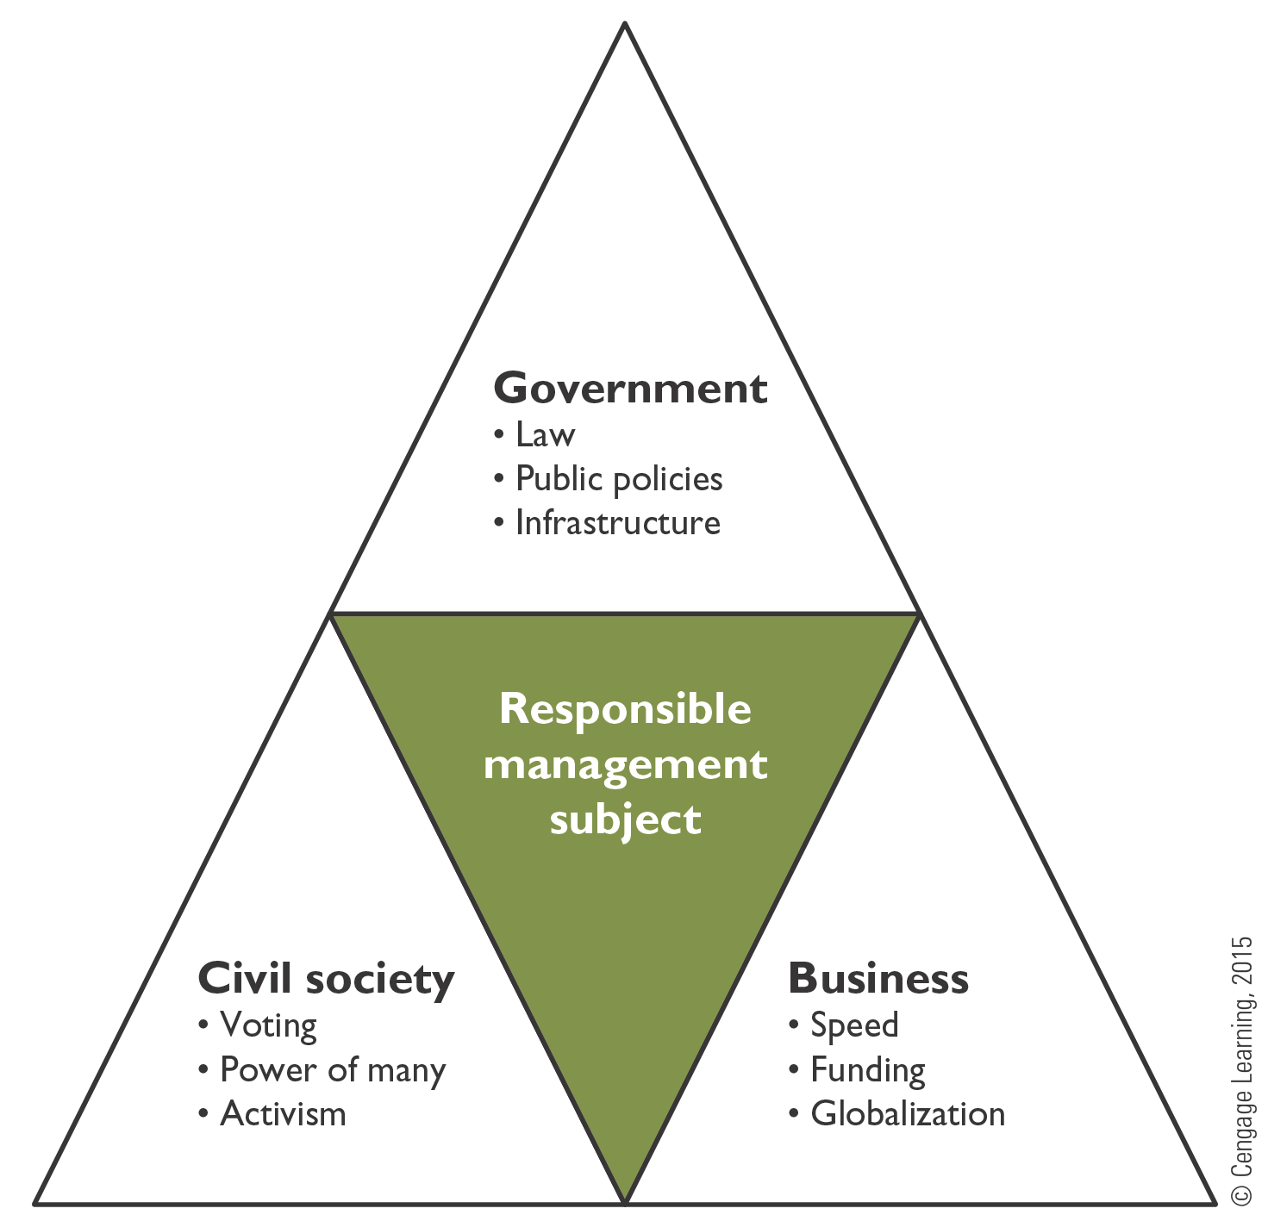
Figure 1.2 Sectorial Actors: Power Resources and Levels

Slide 13
Table 1.2 Sectorial Levels of Action

Slide 14
Business-Related Organizations, Classified by Value Creation and Mission
Mission: Does the organizational mission focus primarily on egoistic motives, such as maximum profit or maximum shareholder value, or primarily on philanthropic motives?
Value creation: Does the value created by the organization accrue externally (for a broad variety of stakeholders) or internally (for owners)?

Slide 15
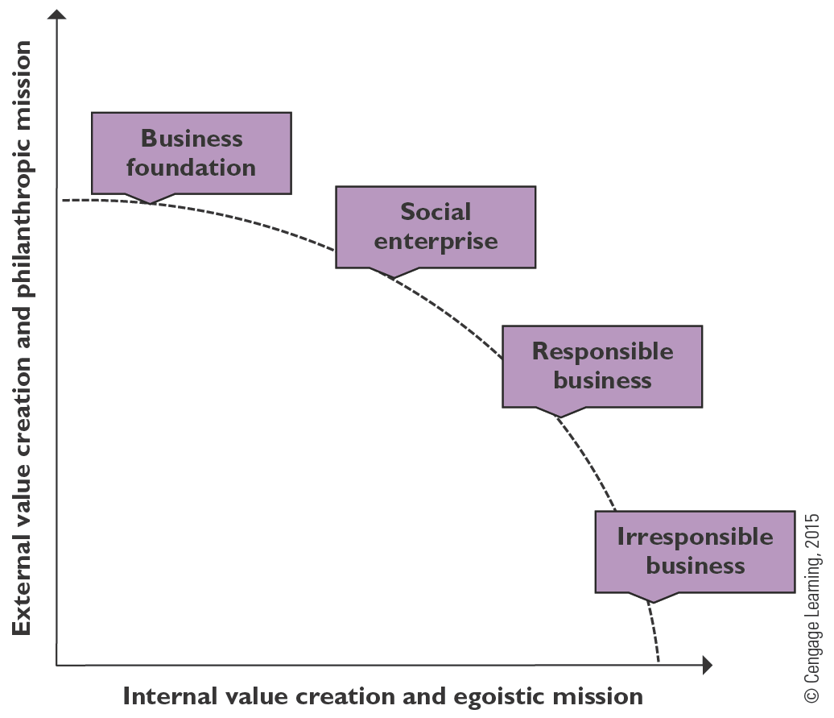
Figure 1.3 Business-Related Organizations, Classified by Value Creation and Mission

Slide 16
THE MEGATREND AND ITS DRIVERS

Slide 17
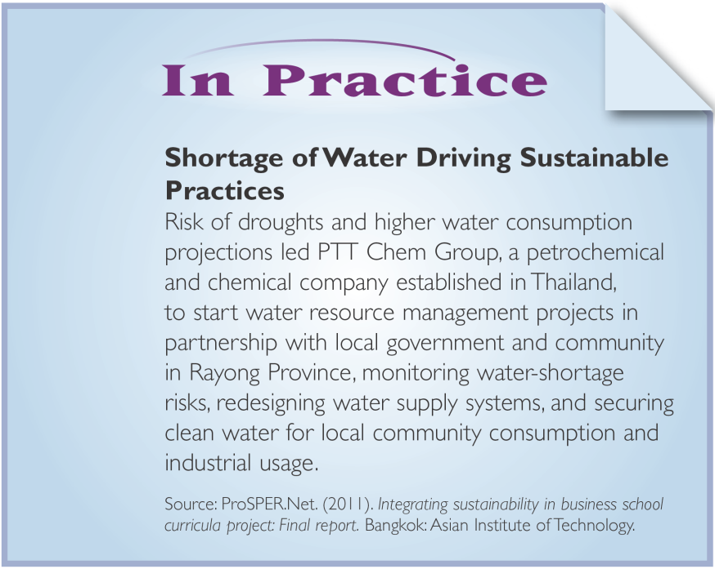
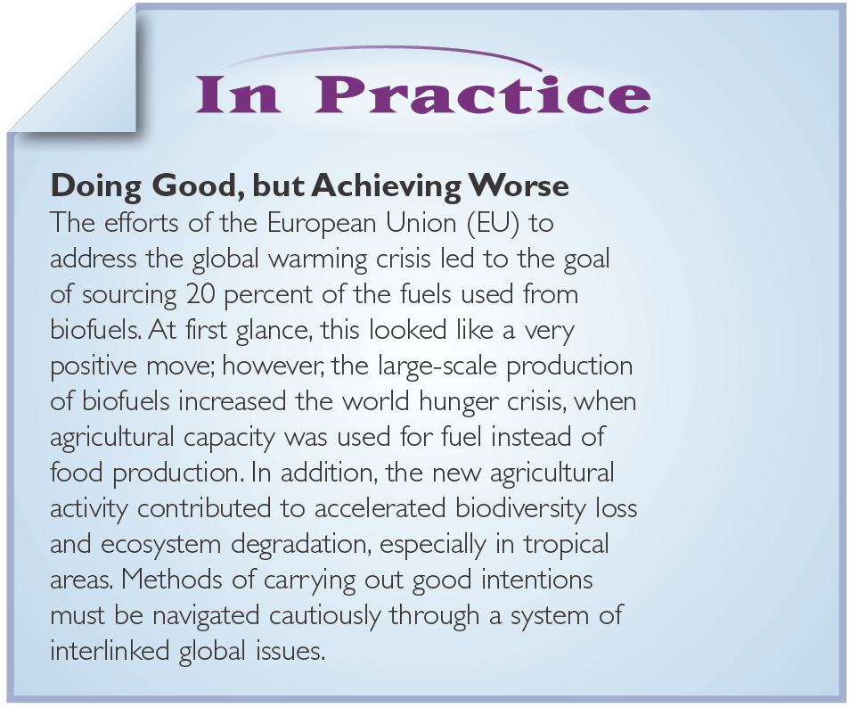
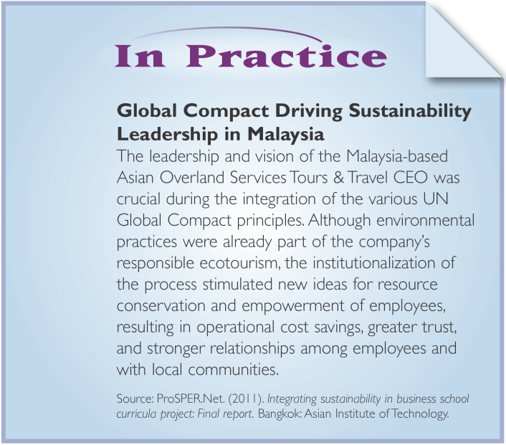
Food for Thought

Slide 18
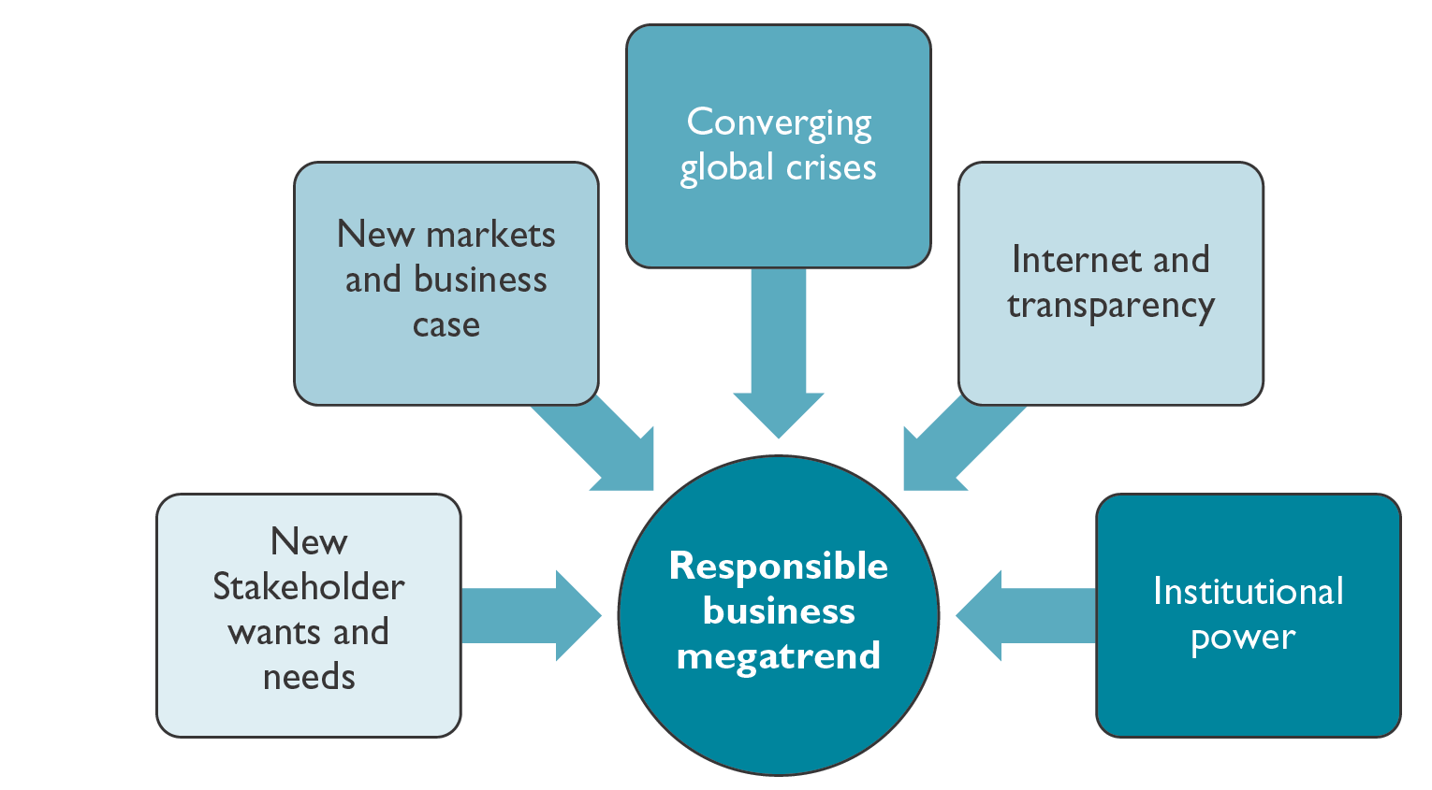
Figure 1.4 Drivers of Responsible Management in Theory and Practice

Slide 19
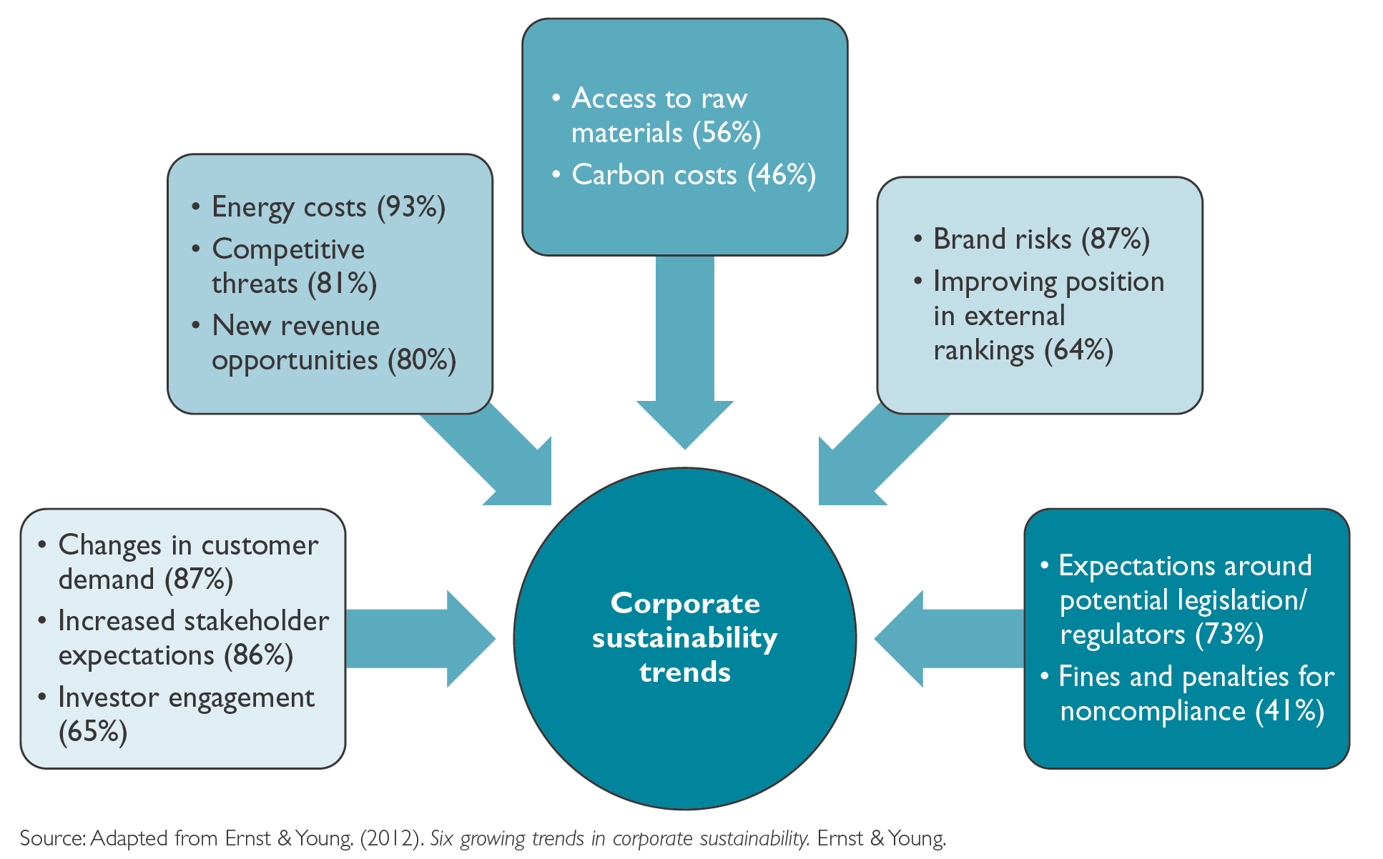
Figure 1.4 Drivers of Responsible Management in Theory and Practice

Slide 20
New Markets and Business Case
New Markets
Consumerist movevment: e.g. LOVOS, LOHAS
Customer attraction and retention, improvement of product quality of products
Business Case
Potential Win-Win or virtuous cycle
Potential benefits: Attraction, motivation, and retention of employees; cost savings; reduced risk; the attraction of new investment; and increased profitability

Slide 21
Converging Global Crises
Potential for global megacrisis
Systemic global challenges
Effect of crises on business
Significance for responsible management
Need to understand crises interrelatedness with business practices
International organizations as sources of information

Slide 22
Internet, Transparency and Globalization
Shared global standards for responsible conduct
Technical factors
Internet availability
Mobile devices
Increased reputation and brand risks and rewards

Slide 23
Institutionalization of Responsible Management
ISO 26 000 (social responsibility) and ISO 14 000 (environmental management)
Global Reporting Initiative (GRI)
United Nations Global Compact (UNGC)
World Business Council for Sustainable Development (WBCSD)
Dow Jones Sustainability Index (DJSI)

Slide 24
BARRIERS, INHIBITORS, AND CRITICISM

Slide 25
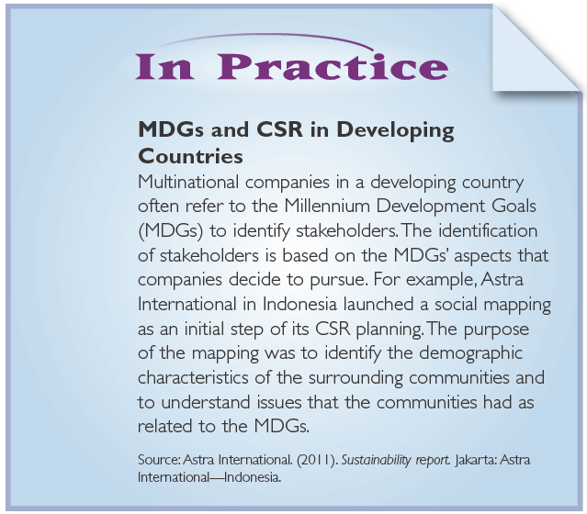
Food for Thought

Slide 26
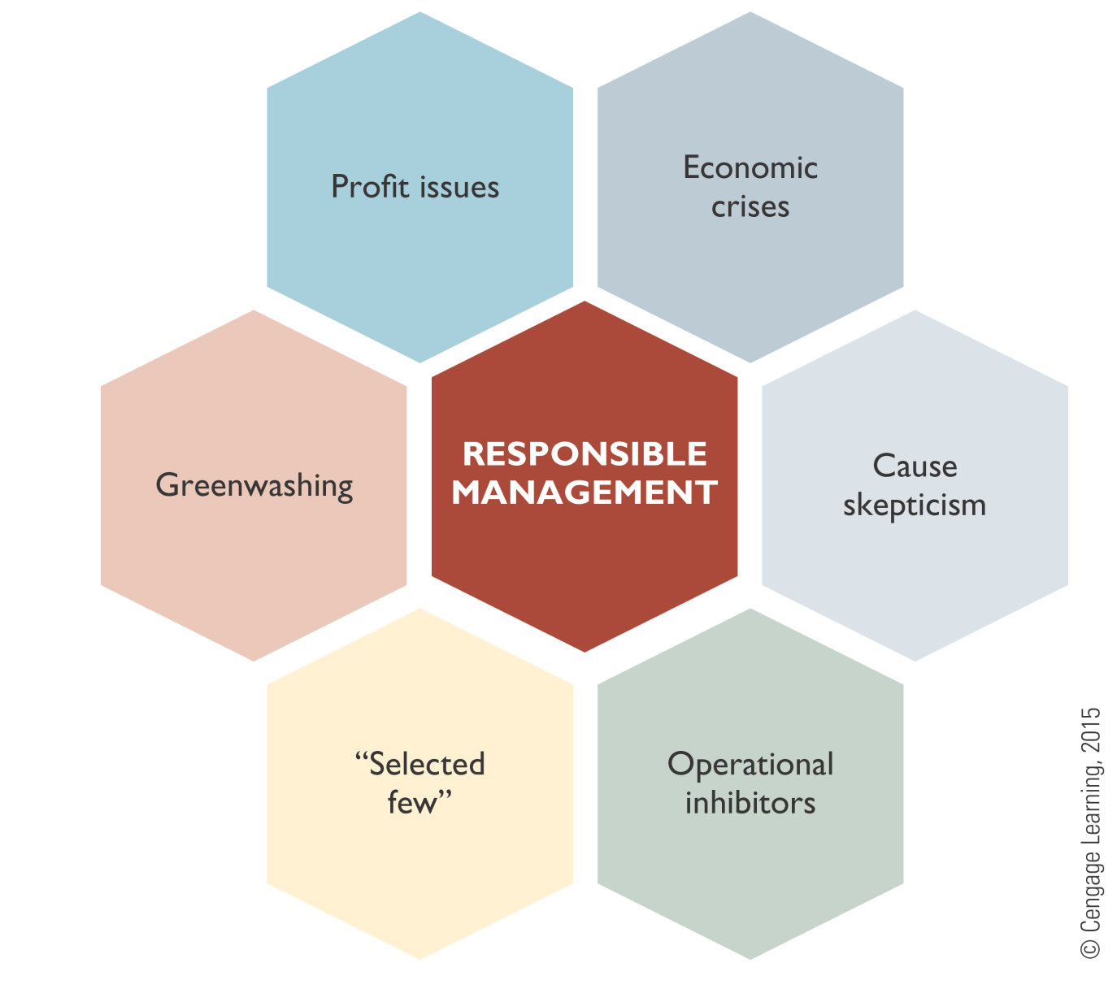
Figure 1.5 Barriers, Inhibitors, and Criticisms in Responsible Management

Slide 27
Typical Profit-Related Criticism in Responsible Business
Questioning profit as good motivation: Companies are focusing on responsible business only to make more profits, to instrumentally and greedily abuse a good topic for profit reasons.
Friedman Argument: The business of business is to generate profit for shareholders, and there is no legitimate responsibility toward any other stakeholder.

Slide 28
Economic Crises
Crisis recommendations
Focus on business case
Align with core business

Slide 29
Greenwashing
The practice of creating a misleading impression of a company´s social, environmental, or ethical performance
Recommendations
“Walk the talk”
Communicate truthfully, abstain from exaggeration and misleading communication

Slide 30
Applicable for Only a “Selected Few”?
Small and medium enterprises (SMEs) versus big corporations
Business-to-business (B2B) versus end-consumer
Developing versus developed countries

Slide 31
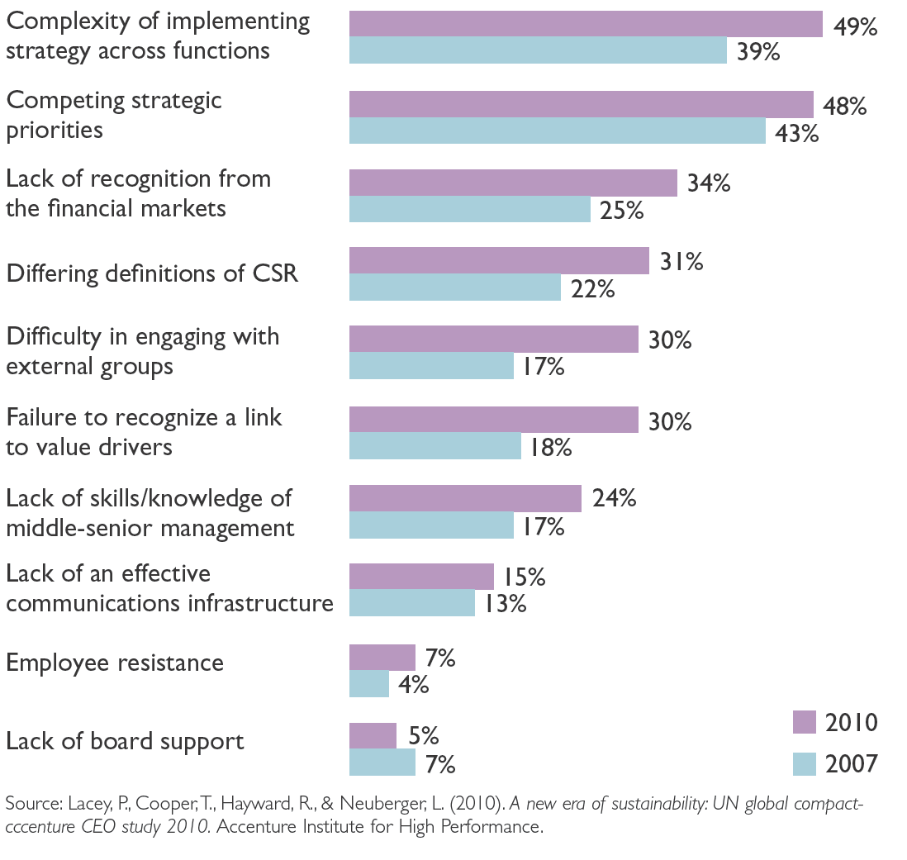
Internal Inhibitors of Responsible Management

Slide 32
Principles of the Context of Responsible Management
Critical factors in the context of responsible management are issues encountered and related actors, drivers, and barriers to responsible management.
Subjects, also called issues or causes, in responsible management can be categorized into the ones relating primarily to the triple bottom line (sustainability), to stakeholders (responsibility), and to moral dilemmas (ethics).
Sectorial actors stem from the governmental, civil society, and business sectors. All three sectorial actors typically provide different solution capabilities for the subjects and issues of responsible management.
All responsible business background domains—sustainability, responsibility, and ethics—may be applied on a micro (individual), meso (organizational), and macro (systemic) level.

Slide 33
Principles of the Context of Responsible Management
Main drivers of responsible management efforts can be grouped into five categories: (1) stakeholder wants and needs; (2) new markets and business case; (3) converging global crises; (4) Internet, transparency, and globalization; and (5) institutional power.
Barriers, inhibitors, and criticisms to responsible management can be grouped into six categories: (1) profit criticism, (2) economic crises, (3) greenwashing, (4) cause criticism, (5) the “selected few” argument, and (6) a set of inhibitors stemming from operational realities.
Greenwashing describes a situation where stakeholders perceive a company as creating a misleading impression of it social, environmental, and ethics performance.
The Friedman argument is the claim that the only responsibility of a business is profit generation, and thus companies and managers should not spend money on responsible business activities.

Slide 34
People in The Context of Responsible Management

